Slide 1



2025
objectives
& KPIs
KPIs
Presented by
Malak Hendawy
Next Slide

Slide 2
SMART
2025
Objective
Drive Sales Growth
Specific: Increase pre-orders for the Class of 2025 senior hoodies through a targeted social media campaign.
Measurable: Aim to generate at least 150 pre-orders before the campaign ends.
Achievable: Leverage school social platforms and student influencers to reach students directly.
Relevant: Senior hoodies are a key graduation tradition and this campaign supports school spirit and merchandise revenue.
Time-bound: Complete the campaign and hit the pre-order goal within 4 weeks.

Slide 3

KPIs
KPIs
Number of pre-orders (Goal: 150+ in 4 weeks)
Social media engagement rate (likes, shares, comments – Goal: 10%+ engagement per post)
Hashtag usage (e.g. #SeniorFit25 – Goal: 100+ unique student posts)
Click-through rate (CTR) on hoodie order links (Goal: 5%+ CTR from Instagram bio and story links)
Reach/impressions on campaign posts (Goal: 10,000+ across platforms)
Email open rate if using newsletters (Goal: 30%+ open rate)
Next Slide

Slide 4
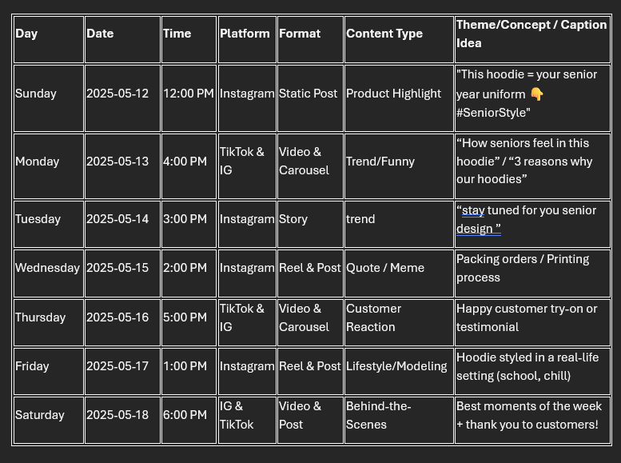
Social Media
2025
Calendar
Next Slide

Slide 5
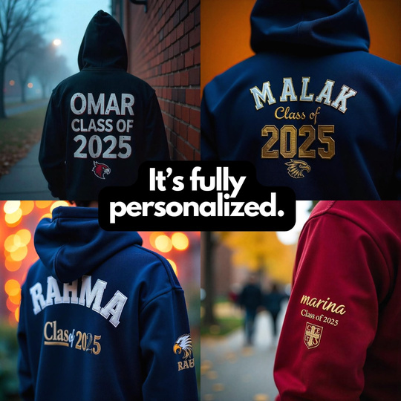
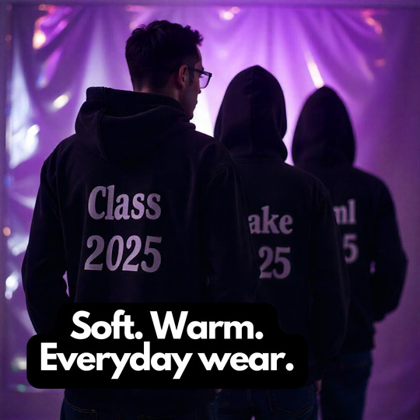
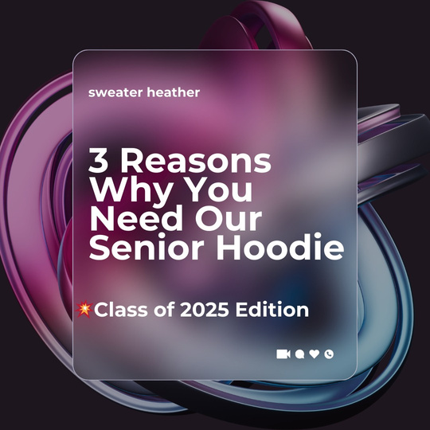


Post
Post
carousel format
2025
creative :
Next Slide

Slide 6
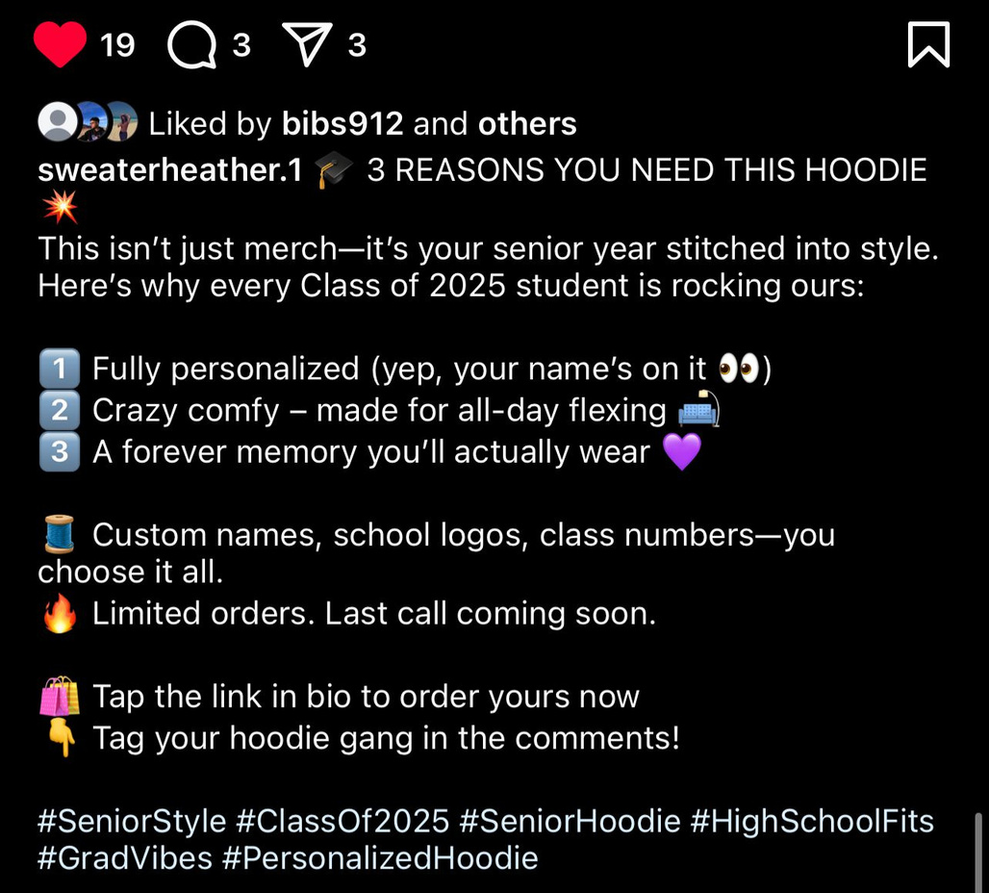
caption :
2025
Next Slide

Slide 7
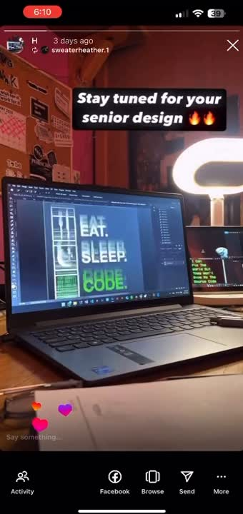
Story
Story
2025
Next Slide

Slide 8
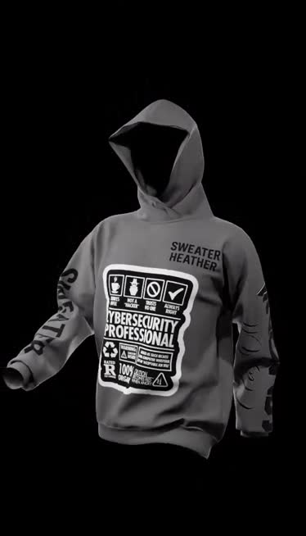
Reel
Reel
2025
creative:
Next Slide

Slide 9
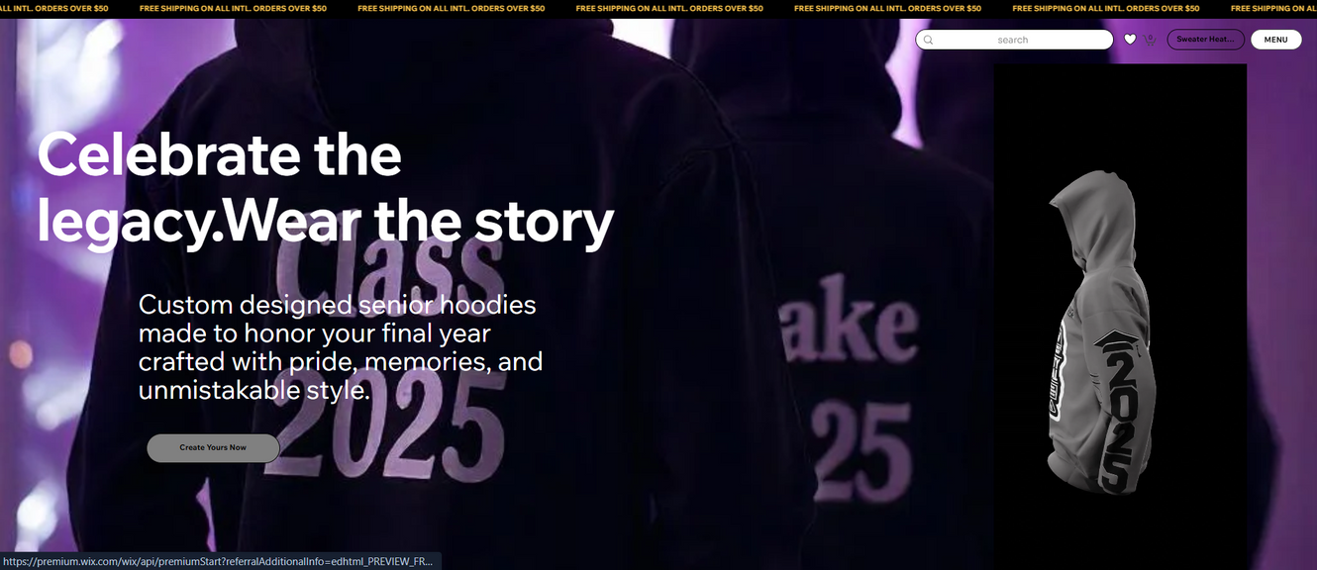
Hero section
Headline:
Celebrate the legacy.Wear the story
subheadline:
Custom-designed senior hoodies made to honor your final year crafted with pride, memories, and unmistakable style.
CTR:
Create Yours Now
Next Slide

Slide 10
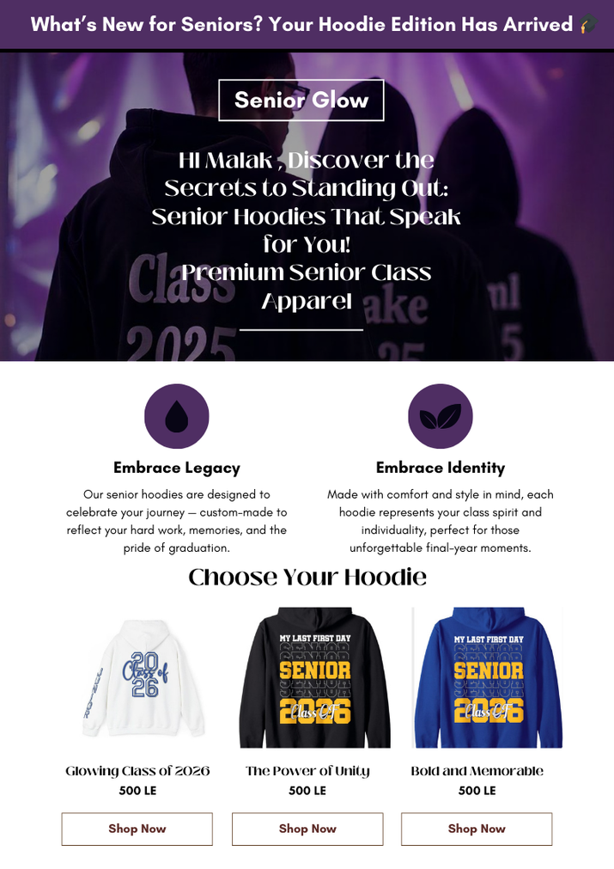
Mail
2025
Newsletter email:
Next Slide

